Slide 1
CIT2C23
Agile Methodology & Design Thinking
Case Study: Prototype (30%)
Student Name (Admin No.):
Tutorial Group:
Tutor:
Submission Date:

Slide 2
Declaration of Originality
I am the originator of this work and I have appropriately acknowledged all other original sources used as my references for this work.
I understand that Plagiarism is the act of taking and using the whole or any part of another person’s work, including work generated by AI, and presenting it as my own.
I understand that Plagiarism is an academic offence
and if I am found to have committed or abetted the offence of plagiarism in relation to this submitted work, disciplinary action will be enforced.
Name and Signature of Student:
<<Replace this with Name and Signature of student>>

Slide 3
Declaration on the use of Generative AI tools for assignments
Describe how you have used Generative AI tools such as ChatGPT or Dall.E-2 in your assignment.
Show snapshots of the conversations with the AI tool (i.e., the prompts you used and the response you get from the AI tool).

Slide 4
How do you indicate the reference?
The content generated by AI tools are not retrievable except by the user who generated them, so they are considered non-recoverable sources. Although non-recoverable data or quotations in APA Style papers are usually cited as personal communications, with ChatGPT-generated text there is no person communicating. Quoting text from ChatGPT chat is therefore more like sharing the output of an algorithm, with a reference list entry and the corresponding in-text citation.
According to the official APA Style site, ChatGPT references should be cited as:
E.g. OpenAI. (2023). ChatGPT (Sep 25 version) [Large language model].
https://chat.openai.com/chat
Important Note:
Do not copy answers produced by the AI tool in totality as it is considered as plagiarism.
Do not rely on any information produced by the AI tool blindly. You should always verify the answer with other sources. Do not assume that these answers provided by the AI tool are correct.
To achieve quality outputs from the AI tool, you should provide good prompt that is clear and specific. Be precise and provide context. Avoid asking open-ended questions.

Slide 5
Introduction
This project aligns with the course objectives by giving students hands-on experience in applying Agile methodology and design thinking to a real-world problem. It will assess their practical knowledge and technical skills in design thinking, Agile processes, and project management. The assessment includes three milestones—Define, Ideate, and Prototype.
This is an individual project
You will be given various case studies and must select one that aligns with your experiences and interests. The chosen case study will be used throughout this assessment as you develop a solution to address it.

Slide 6
Assessment Components
Case Study (80%)
• Part 1: Define (20%)
• Part 2: Ideate (30%)
• Part 3: Prototype (30% | 100 marks): Develop a functional app prototype and organize sprint planning to define sprint backlogs and goals for structured development and conduct user testing by collecting and analyzing feedback through a Feedback Capture Grid.

Slide 7
Your report must include the following:
Low-Fi Design for the UI/UX of your proposed application (30 marks)
Note: You can use Figma or other tools to design the prototype, capture screenshots of your designs, and include links to the prototype.
Prototyping Sprint Planning in JIRA for at least 2 iterations (40 marks)
Sprint Planning – Create a Sprint Backlog of the 2 iteration
Each iteration to provide:
Screenshot(s) of Sprint Backlog and Sprint Goal
Justification of why these Product Backlog Items (PBIs) are selected and the value of the sprint.
User Testing Effectiveness and Impact (30 marks)
Conduct prototype testing and use a Feedback Capture Grid to gather user feedback.
Summarize the results of your prototype testing (videos and notes), including any necessary revisions or improvements. (Rank feedback comments and next steps).

Slide 8
1. Low-Fi Design for the UI/UX of your proposed application (30 marks)
*Feel free to duplicate this slide if necessary
Provide a link to your low-fi prototype. Note: Ensure that your tutor can access the link.
Link to your prototype

Slide 9
2. Prototyping Sprint Planning in JIRA for two iterations (40 marks)
*Feel free to duplicate this slide if necessary
Provide evidence of Sprint Planning for two iterations done in JIRA with screenshots. Make sure the text in the screenshots is visible.
Each iteration to provide:
Screenshot(s) of sprint overview
Screenshot(s) of sprint backlog
Indicate the total story points assigned for the sprint (Estimation)
Reasons why these Product Backlog Items(PBIs) are selected and the value of the sprint.
Note:
An example of Sprint Backlog is provided in the next section.
You can invite your tutor as a user in Jira and provide him/her access. (Based on the tutor’s request)

Slide 10
User Testing Effectiveness and Impact (30 marks)
*Feel free to duplicate this slide if necessary
Conduct prototype testing and use a Feedback Capture Grid to gather user feedback.
Summarize the results of your prototype testing (videos and notes), including any necessary revisions or improvements. (Rank feedback comments and next steps).

Slide 11
User Testing Effectiveness and Impact (30 marks)
*Feel free to duplicate this slide if necessary
Feedback Capture Grid (Note: An example is provided in the next section)
Like THINGS THAT THE USERS LIKE | Wishes Things that can be improved
Questions Questions that have arisen | Ideas Ideas that have arisen from the experience

Slide 12
User Testing Effectiveness and Impact (30 marks)
*Feel free to duplicate this slide if necessary
Summarize the results of your prototype testing (videos and notes), including any necessary revisions or improvements. (Rank feedback comments and next steps).
Include the following:
Videos or detailed notes of user feedback
Detailed analysis of user feedback
Key insights and actionable recommendations drawn from the feedback to improve the prototype.

Slide 13
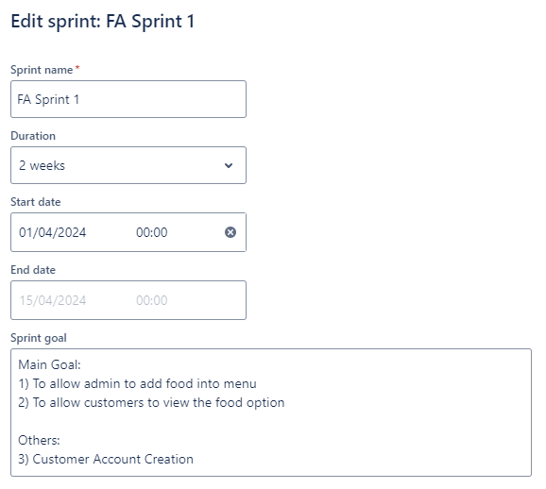
2. Prototyping Sprint Planning in JIRA for at least 2 iterations (40 marks) – Example
Example: Spring Planning Iteration in JIRA with screenshots
Sprint Iteration 1
Screenshot(s) of sprint overview

Slide 14
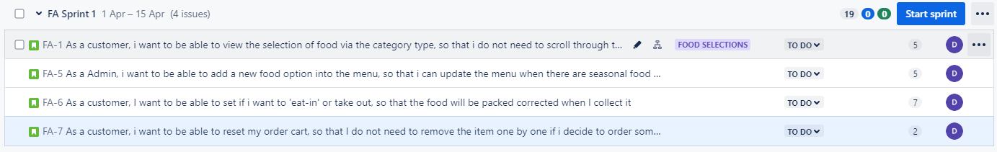
2. Prototyping Sprint Planning in JIRA for at least 2 iterations (40 marks) – Example
Example: Spring Planning Iteration in JIRA with screenshots
Sprint Iteration 1
Screenshot(s) of sprint backlog FA-1: As a customer, I want to be able to view the selection of food via the category type, so that I do not need to scroll through the long list of food options that I am not interested in (5 estimate points) FA-5: As an Admin, I want to be able to add a new food option to the menu, so that I can update the menu when there are seasonal food for sale (5 estimate points) FA-7: As a customer, I want to be able to reset my order cart, so that I do not need to remove the item one by one if I decide to order something else Words must be visible upon zooming in. For user stories that are too long and truncated with '…', you will need to copy and paste the user story and mention the story point estimate.

Slide 15
2. Prototyping Sprint Planning in JIRA for at least 2 iterations (40 marks) – Example
Example: Spring Planning Iteration in JIRA with screenshots
Sprint Iteration 1
Indicate the total story points assigned for the sprint & Reasons why these Product Backlog Items(PBIs) are selected and the value of the sprint.
Total Story Points | 19
Reasons for selected PBIs and the value | E.g : The full e-commerce website is expected to be completed in 8 months. Instead of making the client wait for the full product, we decided to deliver the static pages of the website…. With the static pages done, the client can use the website to advertise while waiting for the full application to be ready….

Slide 16
User Testing Effectiveness and Impact (30 marks) - Example
Like THINGS THAT THE USERS LIKE The buttons are big and clearly labelled, like "Plan Journey" and "Stop Navigation." They are easy to see and tap. The yellow and black colour scheme is quite clear, making text easier to read. The steps are simple. I just enter my location and destination and it plans everything for me. Step-by-step navigation is helpful, especially when finding exits and lifts The step-by-step navigation is helpful, especially for someone unfamiliar with MRT routes. Audio guidance is helpful because I rely on hearing more than reading small text Voice-automated interaction allows for hands-free operation, making it easier to navigate without needing to hold the phone. Good to have an emergency button that connects to station staff. I feel safer knowing I can get help if I am lost or unwell. | Wishes Things that can be improved Offer multilingual support. Customisable speech speed for those who need slower or faster voice instructions. Mention visible signs or landmarks in directions (e.g., “turn left after the ticketing machine”). Allow users to choose between receiving directional instructions in steps or metres, providing more flexibility in navigation. Train arrival details should be more prominent. Helpful to incorporate real-time train crowd levels, allowing users to decide whether to wait for the next train.
Questions Questions that have arisen Is voice navigation available only in English? Will the app always give voice instructions or can I toggle to text-based instructions instead? How does the voice navigation work? Does it repeat instructions if I miss them? If I make a wrong turn, will the app tell me how to get back on track? Will AI adequately describe the station surroundings? Can I save my favourite routes? Does this app work in underground stations where I sometimes do not get signal? | Ideas Ideas that have arisen from the experience Adding subtle vibrations for turns, stops or important alerts. Allow automatic detection of abnormal movement or long inactivity and prompt users if they need help. Allow users to save frequent routes. Allow users to set custom profiles.

Slide 17
References

